Slide 1
Regression and Boosting
Wages Prediction
Xiaochen Cui
ID: 2101390

Slide 2
Problem Overview
1

Slide 3
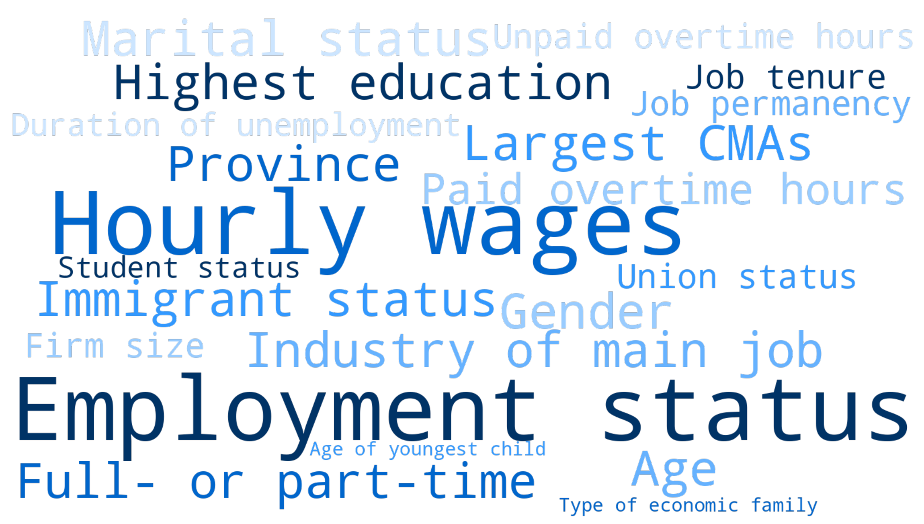
1.1 Canada Employment Dataset
Source: https://www150.statcan.gc.ca/n1/en/catalogue/71M0001X
Etries:113780, Columns:60, Some of features are as follows

Slide 4
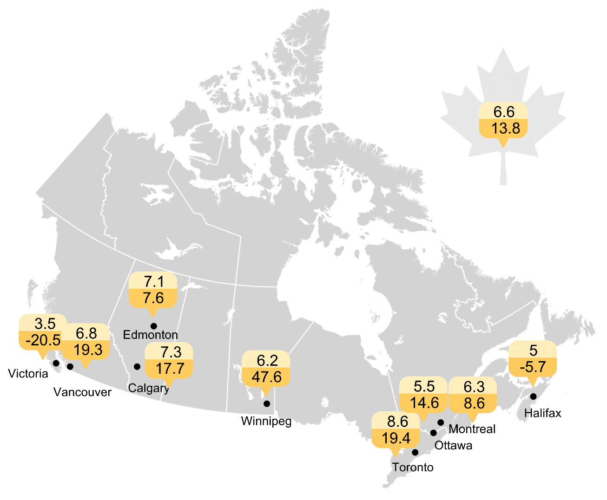
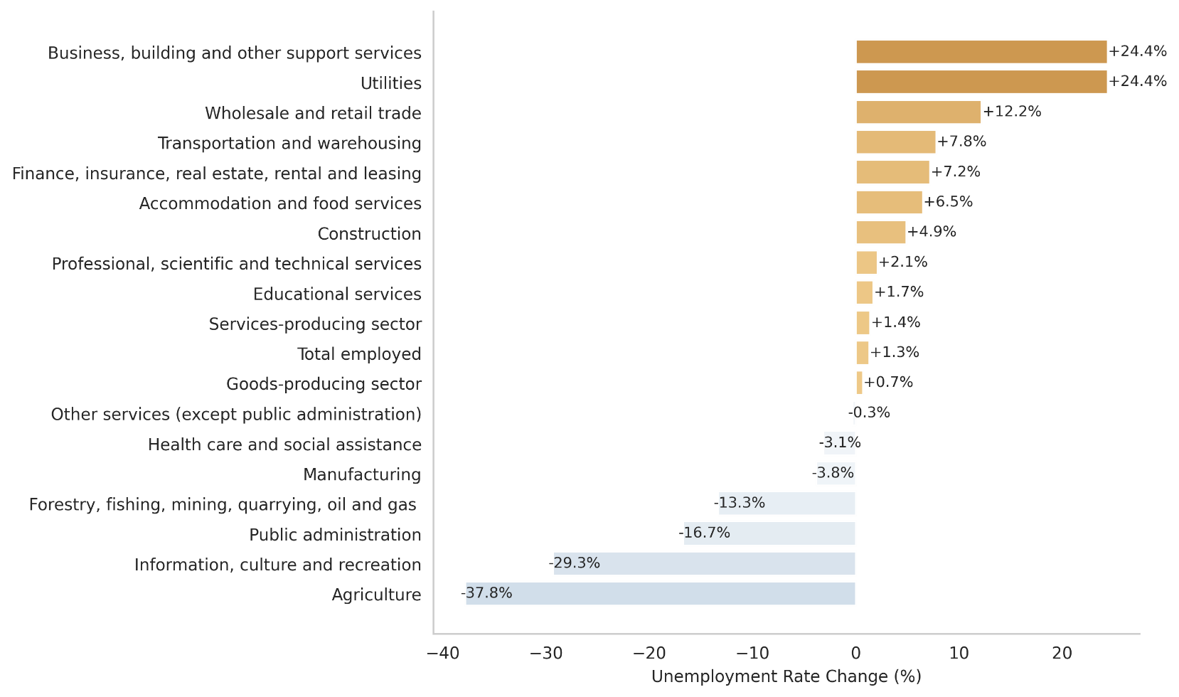
1.2 Dataset Infos
---What we learn from this dataset
Unemployment rate on 25 Feb
Annual unemployment rate change
Unemployment rate in metropolitan areas
on 25 Feb and change from 24 Feb.
Annual Employment Rate Changes in Vancouver’s Industries

Slide 5
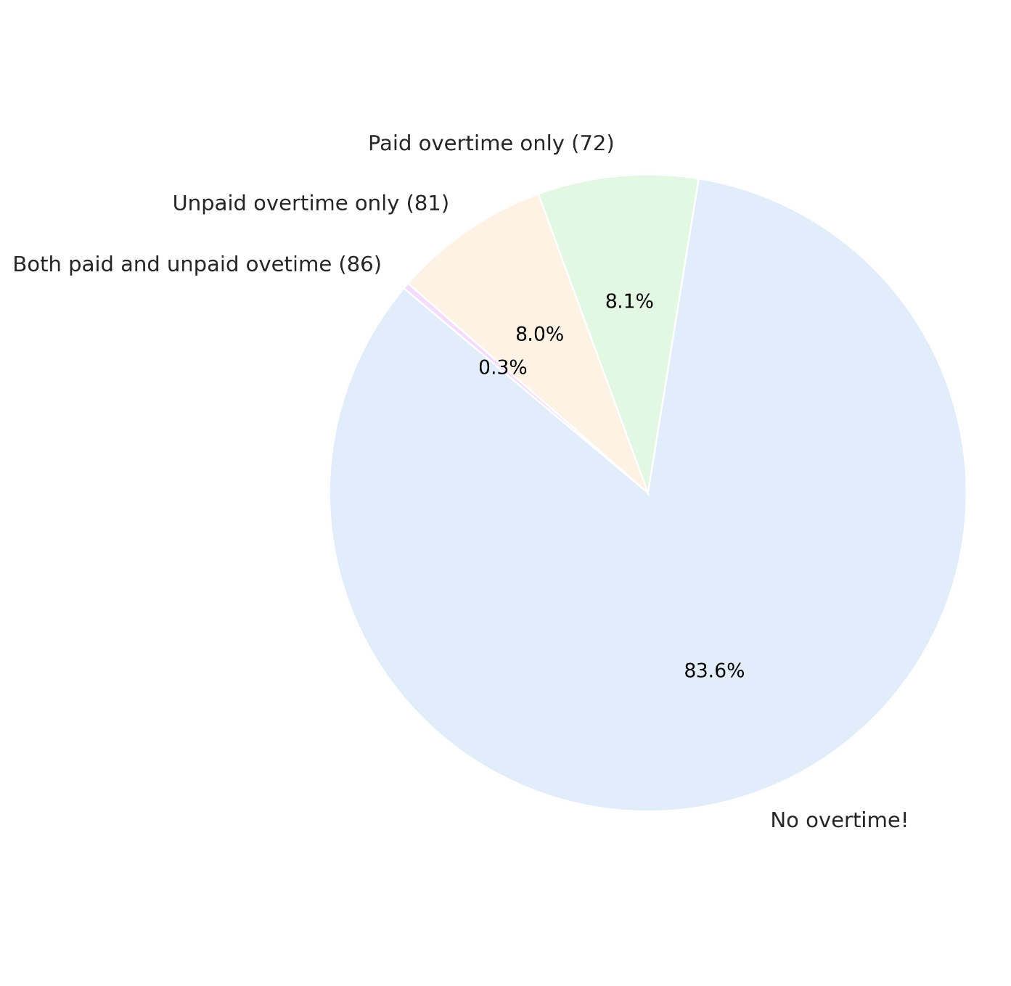
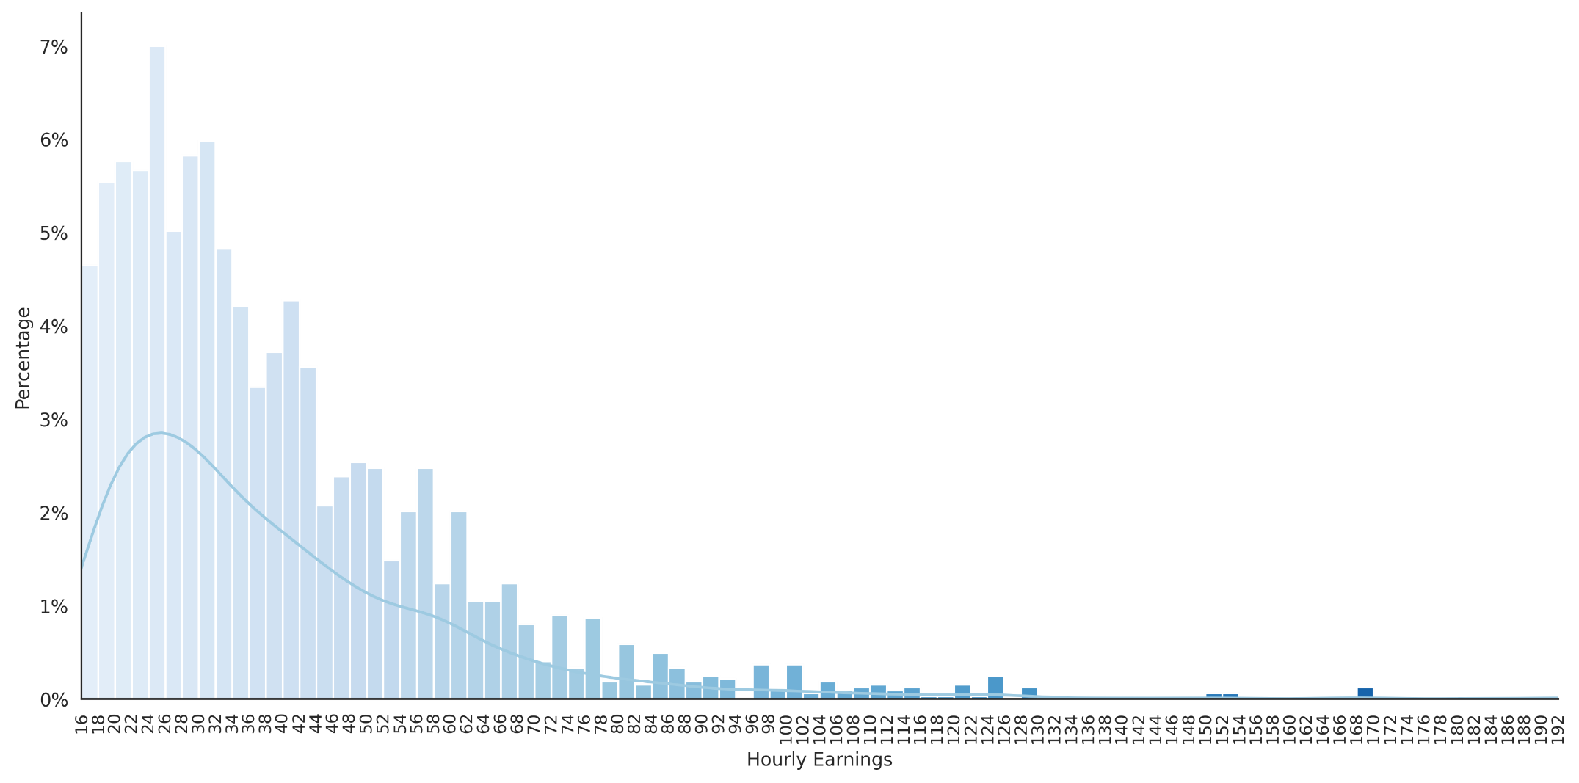
1.2 Dataset Infos
---Is this dataset interesting?
Hourly wages distribution in Vancouver
Working overtime ratio and weekly overtime hours in Vancouver

Slide 6
1.3 Key Questions of Interest
Classification
Can we forecast whether someone gets the job or remains unemployed?
Can we predict if a person works full-time or part-time?
Can we predict if a job is permanent or temporary?
Can we classify individuals will work overtime or not?
Regression
Can we predict a person's hourly wage?
Can we predict the number of overtime hours a person works?
Can we estimate the number of weeks a person is absent from work?
Clustering
Can we discover distinct workers based on job and demographic features?
Can we cluster occupations by similar work hours, tenure, and wage patterns?
Can we group regions with similar labour market characteristics?

Slide 7
Model Comparisons
2

Slide 8

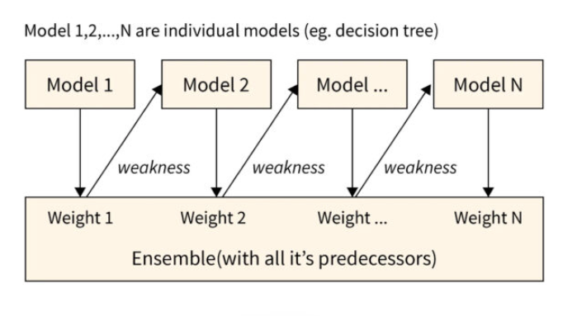

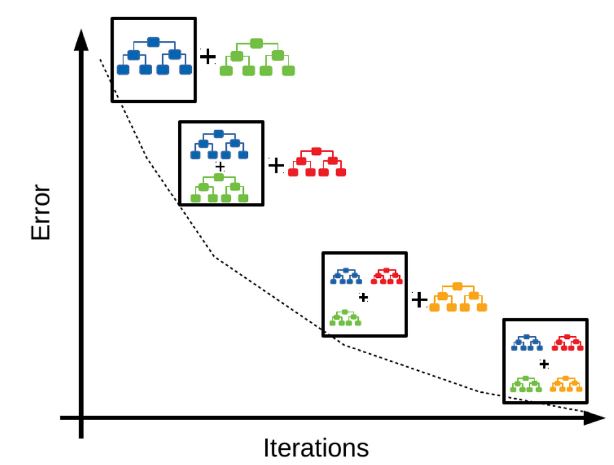
2 Model Comparisons
Notes:
Underfitting is when the model is too simple to capture the patterns, lead to low accuracy

Slide 9
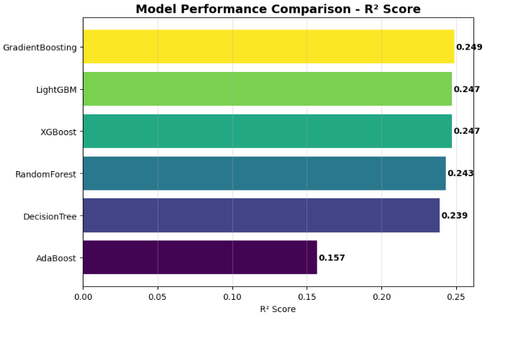
2 Model Comparisons
- R² measures how well a regression model fits the data. The higher, the better.
- Boosting models (Gradient Boosting, LightGBM, XGBoost) performed best by learning from previous errors and capturing complex patterns.
- They handle mixed features (like age and education) well and reduce both bias and variance.
- Random Forest and Decision Tree are less precise since they don’t refine mistakes across trees.
- AdaBoost underperformed due to its simplicity and sensitivity to noisy wage data in regression tasks.
Notes:
Underfitting is when the model is too simple to capture the patterns, lead to low accuracy

Slide 10
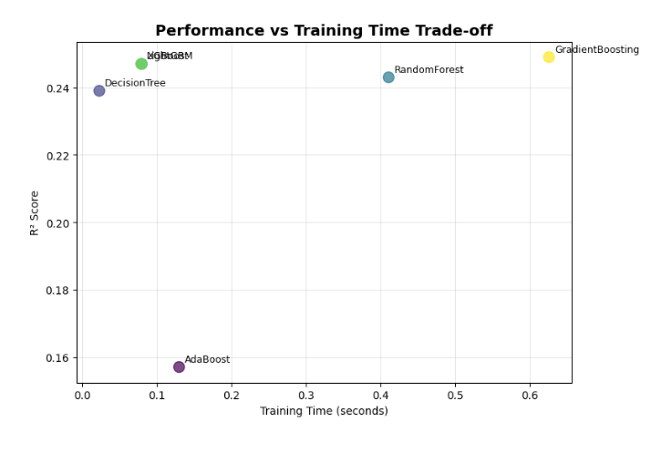
2 Model Comparisons
Gradient Boosting achieved the highest accuracy by learning sequentially, but took the longest to train.
LightGBM and XGBoost balanced speed and performance best thanks to their optimized algorithms.
AdaBoost had low accuracy and slow training due to its weak learners and poor fit for regression tasks.
Notes:
Underfitting is when the model is too simple to capture the patterns, lead to low accuracy

Slide 11
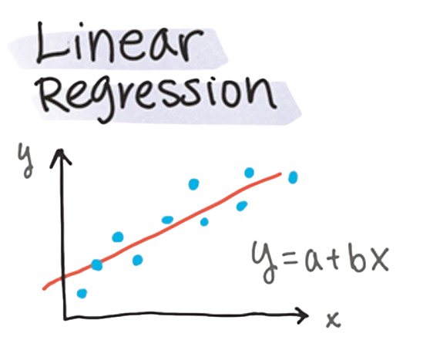
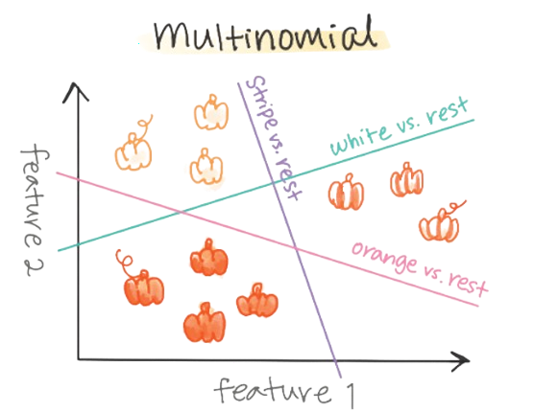
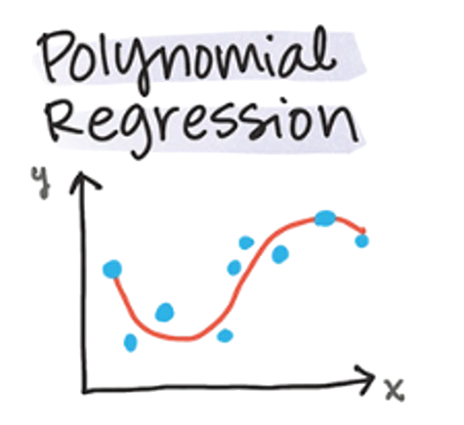
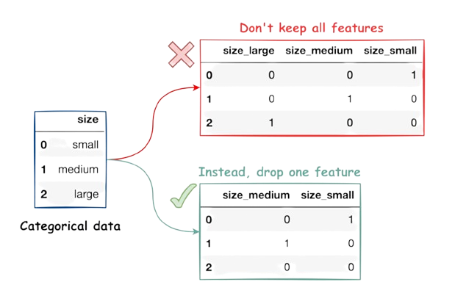
2 Model Comparisons
Notes:
Underfitting is when the model is too simple to capture the patterns, lead to low accuracy

Slide 12
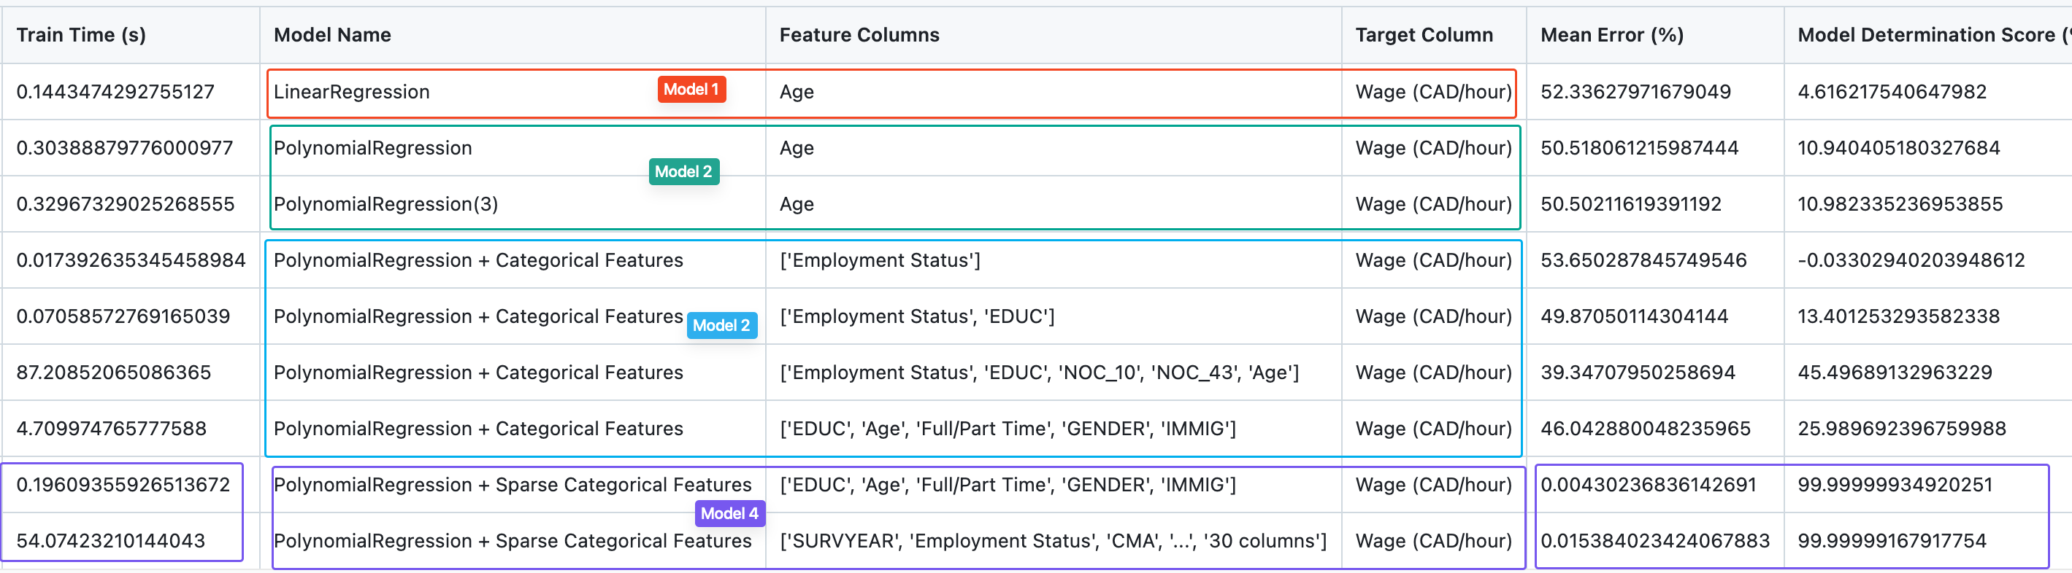
2 Model Comparisons
Notes:
Underfitting is when the model is too simple to capture the patterns, lead to low accuracy

Slide 13
Key Insights
Gradient Boosting, LightGBM, and XGBoost gave the best accuracy—boosting methods learn from errors and capture complex patterns.
LightGBM stood out for its speed–it matched Gradient Boosting’s accuracy but trained much faster, making it ideal for large datasets.
AdaBoost underperformed due to its weak learners and noise sensitivity, while Random Forest was solid but less precise than boosting models.
Linear models (including polynomial forms) can outperform tree-based models when combined with proper feature encoding and rich input features.

